Slide 1

Machine Learning for Fraud Detection
Using Random Forests to Identify Fraudulent Transactions
Presented by Terry Brown, Elijah Mercier and Ivanna Price

Slide 2


About Our Project
Our project focused on using machine learning to detect fraudulent transactions in financal datasets.
Industry: Finance
Model Used: Random Forest Classifier
In this presentation, we will demonstrate how we successfully built a model that achieved over
95% accuracy in identifying fraudulent transactions.

Slide 3


WHY FRAUD DETECTION MATTERS:
Billions of dollars are lost to fraud annually.
Detecting fraudulent transactions in real-time can save money and improve consumer trust.
Our Goal: Develop a predictive model to identify fraudulent transactions using machine learning.
Key Questions:
At what distances are fraudulent transactions more prevalent?
Which characteristics of a transaction are the most important in detecting fraud?

Slide 4
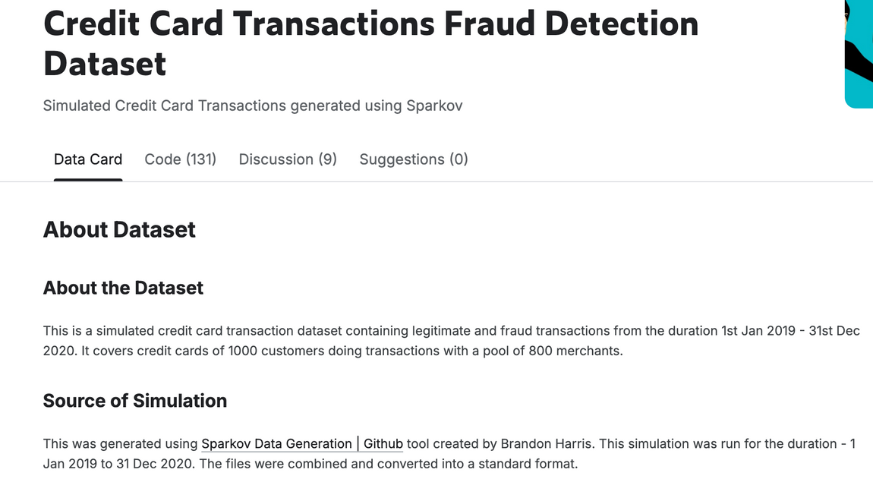
Data Collection
The data was sourced from Kaggle’s "Fraud Detection" dataset.
Our dataset included over 1 million records with 23 features.
Highlight important features like amt, lat, long, transaction_year, transaction_month, etc.
Target Variable: is_fraud (1 indicates fraud, 0 indicates non-fraud)

Slide 5
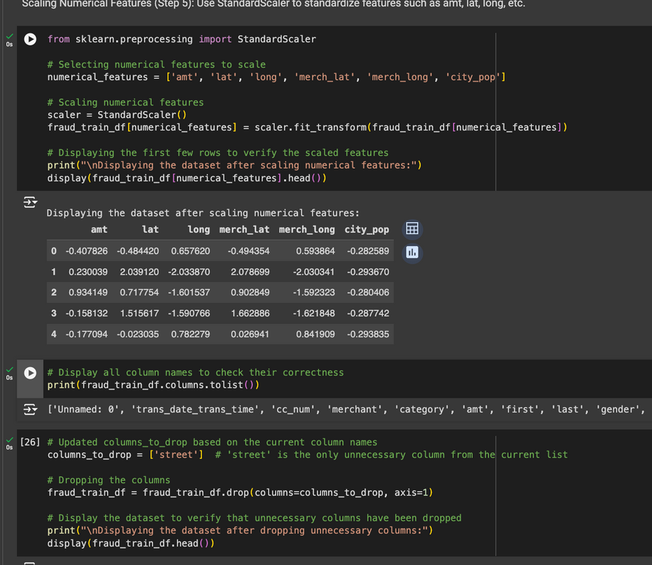

Data Preparation
Effectively cleaned data in cases such as:
Removing unnecessary columns (i.e., street).
Converting trans_date_trans_time to separate year, month, day, hour features.
Encoding Categorical Variables: label encoding for gender, job, category.

Slide 6
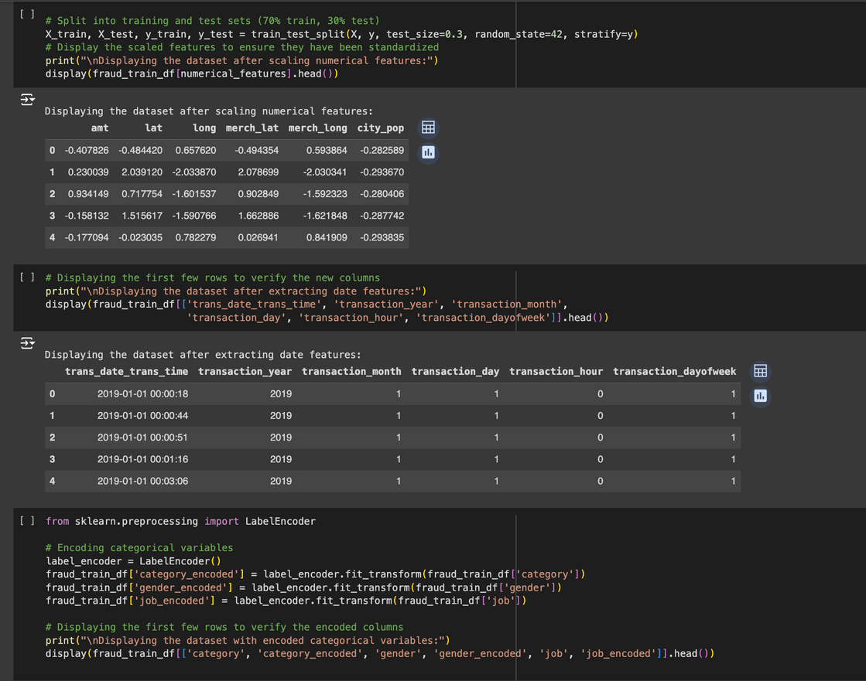
Model Selection and Training
Chosen Model: Random Forest Classifier
Justification: The Random Forest model is robust, handles large datasets, and deals with feature importance well.
Training Process:
Split data into training (70%) and testing (30%) sets.
Used scikit-learn to train the model with 50 estimators.
train_test_split() splits the data into 70% training and 30% testing, using stratify=y to ensure the is_fraud ratio is maintained in both sets.

Slide 7
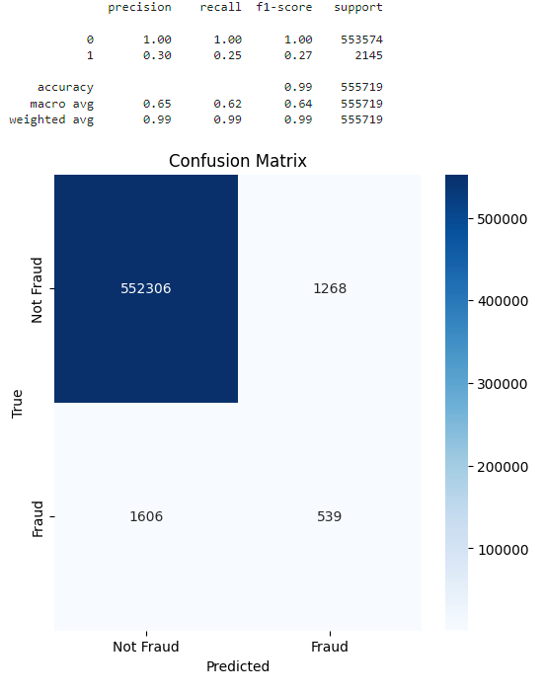
Model Evaluation
Metrics Used:
Accuracy: 99%
Precision, Recall, F1-Score
Confusion Matrix: Expresses accuracy of model by comparing predicted values with actual values
Model correctly identified 552,306 non-fraudulent transactions with very few false positives. The model correctly detected 539 fraud cases, but missed 1,606, indicating room for improvement
Precision, Recall, Accuracy, Weighted Average Score:
The accuracy score of 0.99 indicates excellent model performance.

Slide 8
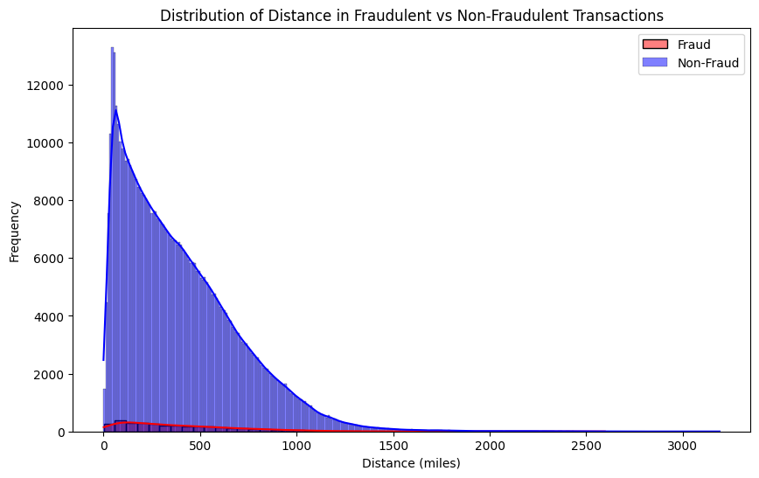
Distance Distribution
Overview: Represents the distribution of distances between the cardholder’s address and the retailer’s location for fraudulent and non-fraudulent transactions.
Non-fraudulent transactions
Most occur over short distances, peaking around 0 - 100 miles
Fraudulent transactions
More spread out across a wider range of distances compared to non-fraudulent transactions
Noticeable “tail” of fraudulent transactions at larger distances (500+) miles

Slide 9
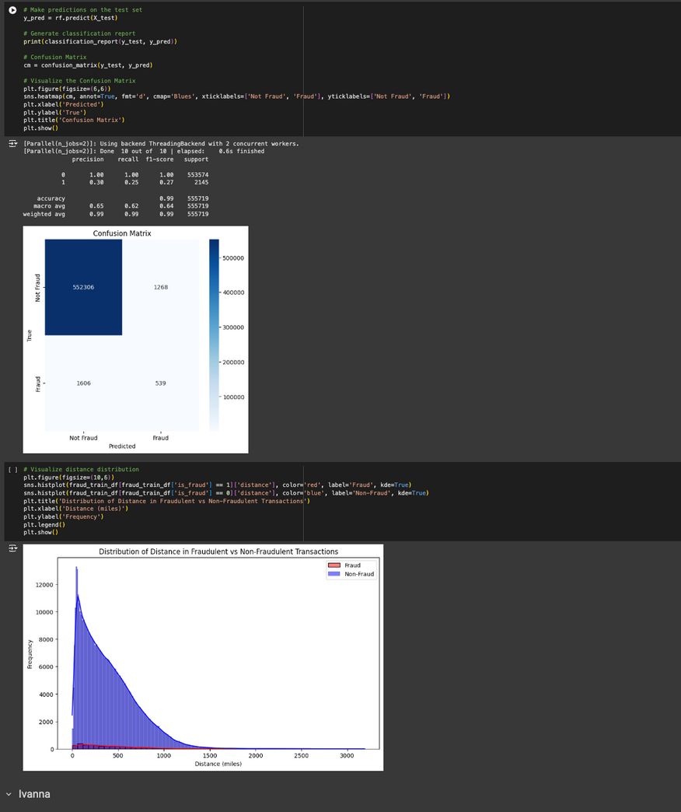
Data Exploration and Analysis
Exploratory Data Analysis (EDA):
Visualized distributions of transaction amounts (amt) and distances to locations (miles).
Analyzed correlations between features and the target variable.
Key Insights:
Most fraudulent transactions occurred less than 500 miles away.
Certain categories (e.g., amount) had higher impact on probability of fraud rate.

Slide 10
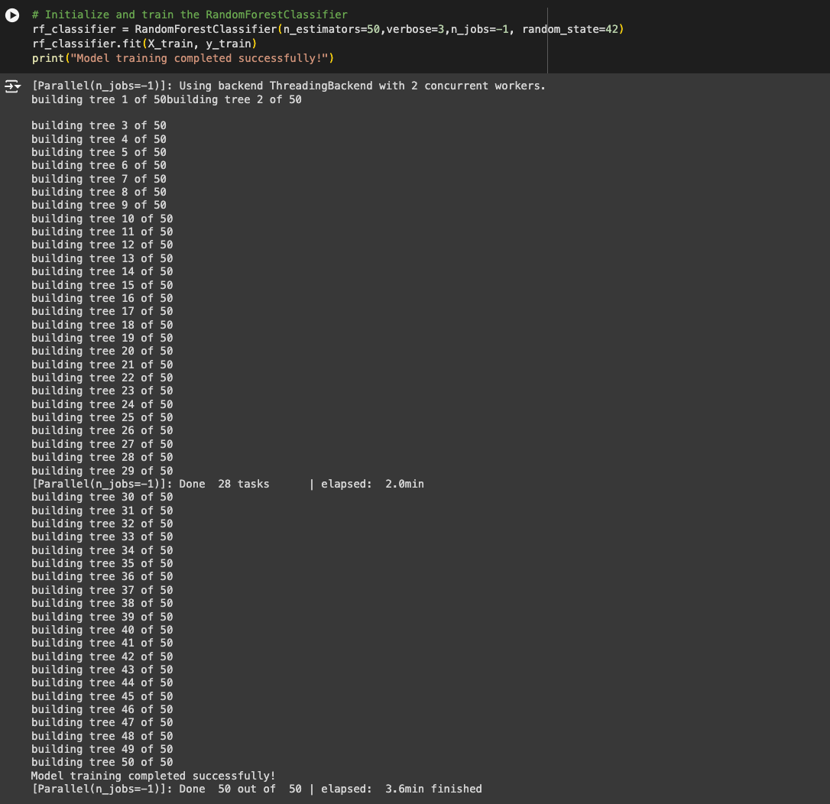
Model Selection and Training 2
n_estimators=50: Specifies that the model will create 50 decision trees.
random_state=42: Ensures reproducibility.
rf_classifier.fit(X_train, y_train): Trains the model using the training dataset.

Slide 11
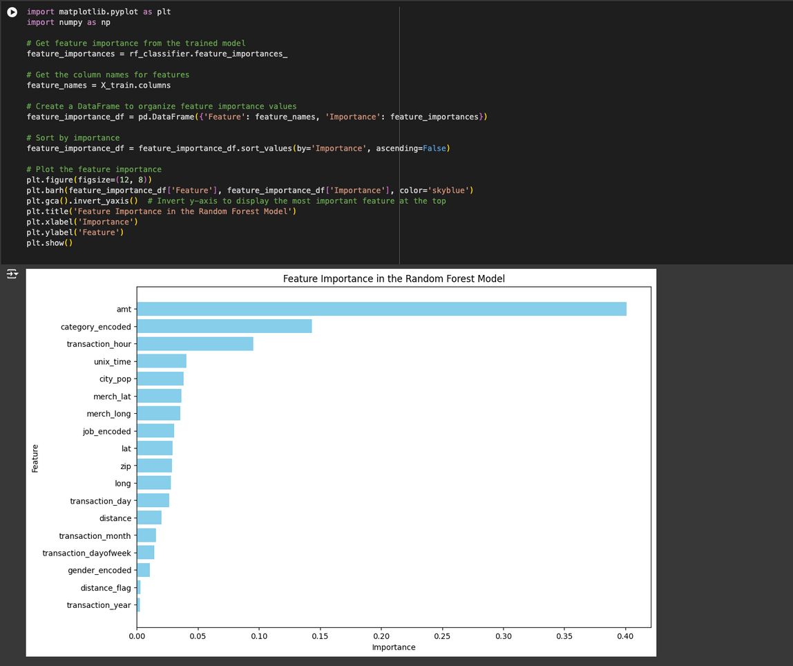
Feature Importance
Transaction amount (amt): Most important feature in detecting fraud. Higher transaction amounts could be indicative of fraud
Category (category_encoded): Second most important feature. The type of merchant or transaction category (e.g., travel, entertainment, or personal care) can be significant in identifying fraudulent behavior
Distance is relevant, but is not a strong predictor when compared to the features noted above

Slide 12



Challenges and Solutions
Challenges Faced:
Handling imbalanced data: Fraud cases were much fewer than non-fraud cases.
Dealing with categorical data and timestamps.
Solutions Implemented:
Used stratified sampling and handled imbalanced data with appropriate evaluation metrics.

Slide 13
Conclusion
Key Takeaways:
The Random Forest model effectively identified fraudulent transactions with high accuracy.
While most transactions—fraudulent or not—occur at distances less than 100 miles, fraudulent transactions tend to occur more frequently at greater distances, particularly over 500 miles.
Feature importance analysis revealed that transaction amount (amt) and distance from location (miles) were critical indicators.
Business Impact: Our model can be deployed to detect fraudulent transactions in real-time, potentially saving financial institutions millions of dollars.

Slide 14

Thank You

